Slide 1
Subject Name :Mobile Computing Presentation Title: Satellite Communication
JEPPIAAR INSTITUTE OF TECHNOLOGY
“Self-Belief | Self Discipline | Self Respect”
Department of Computer Science and Engineering
Team Members:
Students Name Reg.No:
1. THALARIVENTHAN 210617104053
2. RONNIE BERT 210617104046
3. JEFLIN 210617104024
4. PRANAV 210617104042
5. DHIVAKAR 210617104016
6. HEMANTH 210617104020

Slide 2
Objective
To Design/ Analyze/ Evaluate

Slide 3
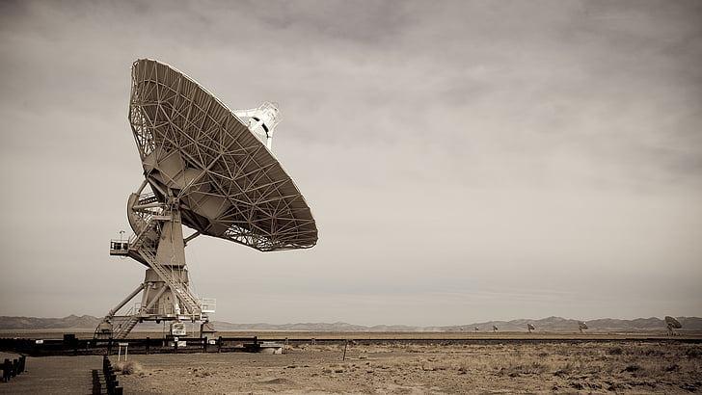
Technical Details
Satellite communication
Satellite - Artificial celestial body
Satellit ( latin )- attendant
Over 2216 satellites around the Earth

Slide 4
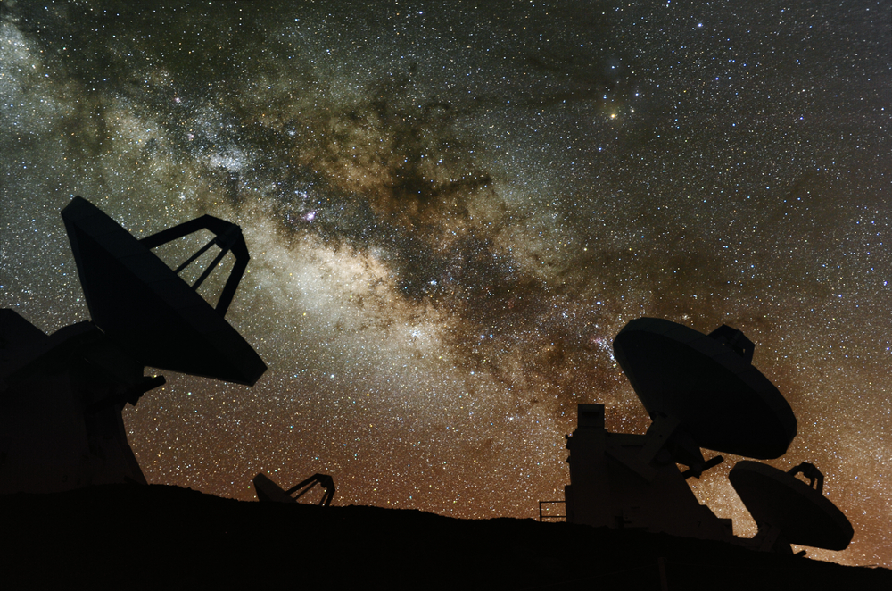
Block Diagram/ Work Flow/ Flow Chart
Types of satellites
Communications Satellite
Remote Sensing Satellite
Navigation Satellite
Drone Satellite
Ground Satellite
Polar Satellite
Nano Satellites or SmallSats

Slide 5
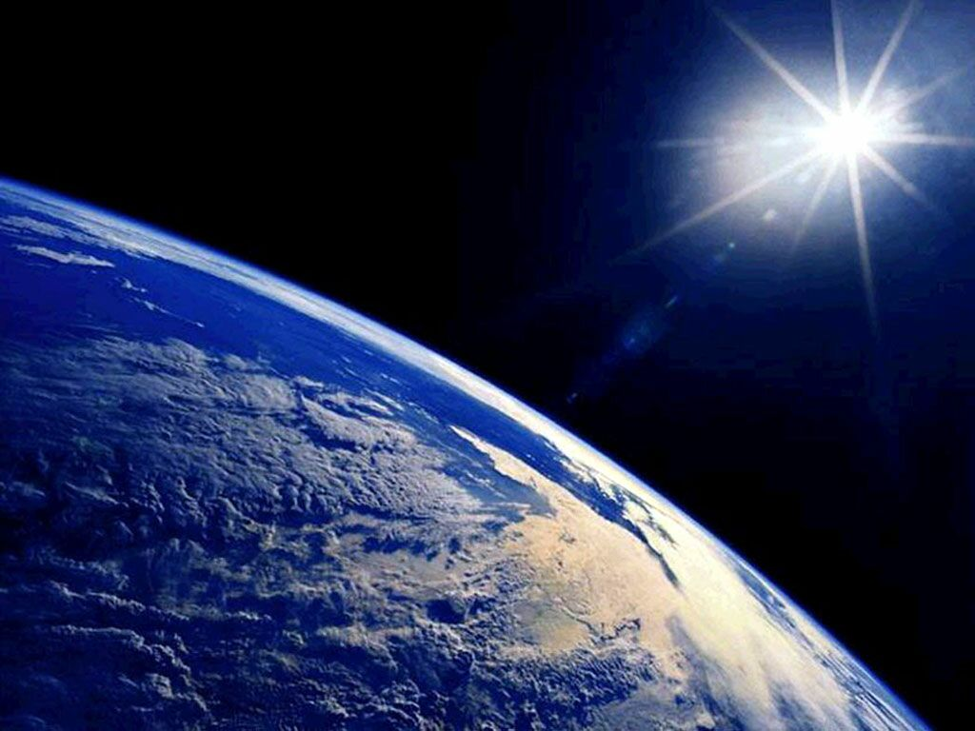
Technical Details
ORBIT
Geostationary orbit (GEO)
Low earth orbit (LEO)
Medium earth orbit (MEO)
Molniya orbit

Slide 6
Technical Details
Geostationary orbit: If an observer on the earth observes the satellite in the geostationary orbit then the satellite looks stable because the satellite revolves around the earth. The geostationary satellite is useful in exchanging the information because the antenna on the ground can be intended at the satellite without tracking the motion of the satellite. The foremost geostationary satellite was the Syncom3 and it was launched on 19th of August and in the year of 1964.

Slide 7
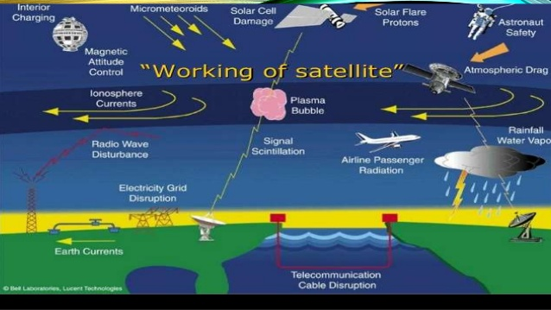
Technical Details

Slide 8
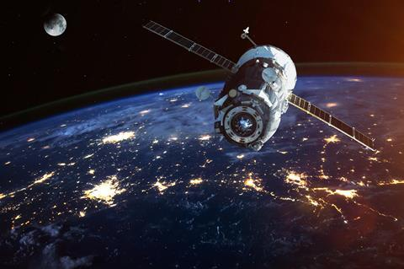
Technical Details
Services
Communication via satellites.
Service of whether survey
Military applications
Meteorological satellite service
Fixed satellite service
Broadcast satellite service
Navigational satellite service
Mobile satellite service

Slide 9
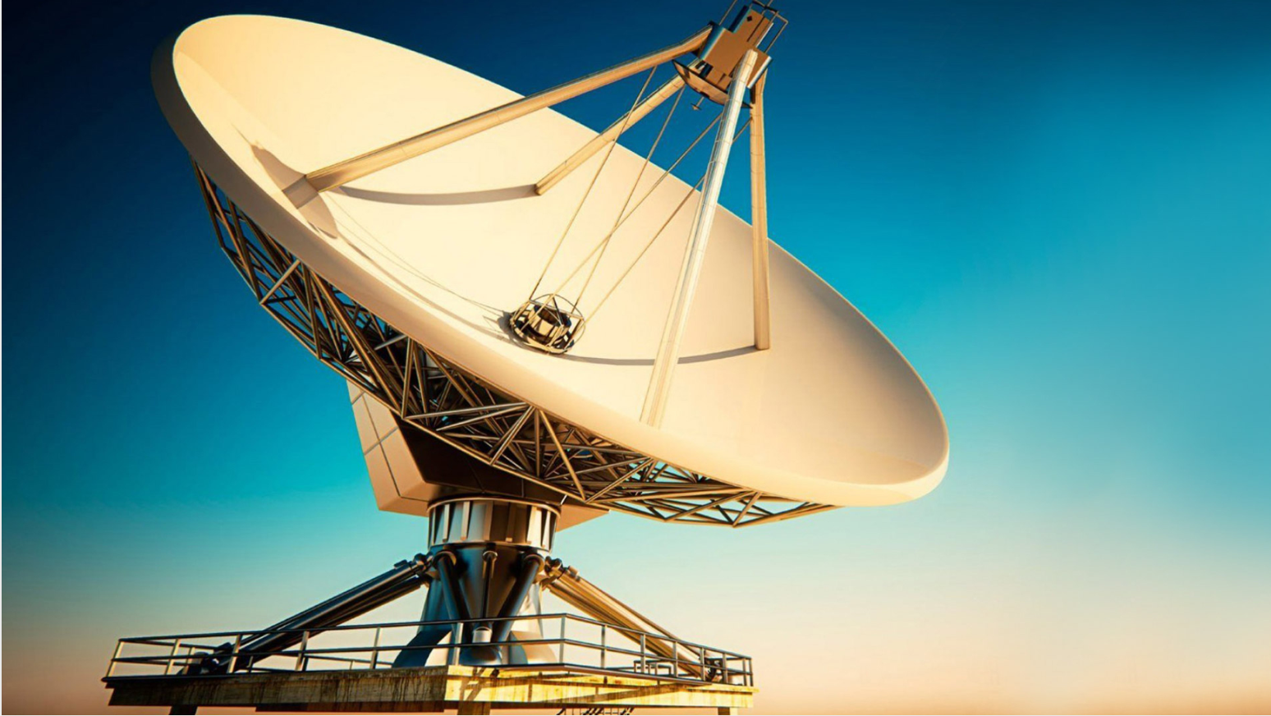
Technical Details
Advantages:
High channel capacity along with low error rates.
Stable cost environment and covers a wide area

Slide 10
Result & Discussion
Low earth orbit: A low earth orbit is a type of a circular orbit about 200 meters above the surface of the earth and it corresponds a time period of about 90 minutes to revolve around the earth. The satellites orbiting in the low earth orbit are less expensive to launch when compared with the satellites in the geostationary orbit. The Iridium and Globalstar are the two satellite constellations the aimed to furnish satellite phone services to the remote areas.
Medium earth orbit: The satellites of medium earth orbit lies between 8000 km to 18000 km above the surface of the earth. The satellites of medium earth orbit work in a similar manner like the satellites of low earth orbit.

Slide 11
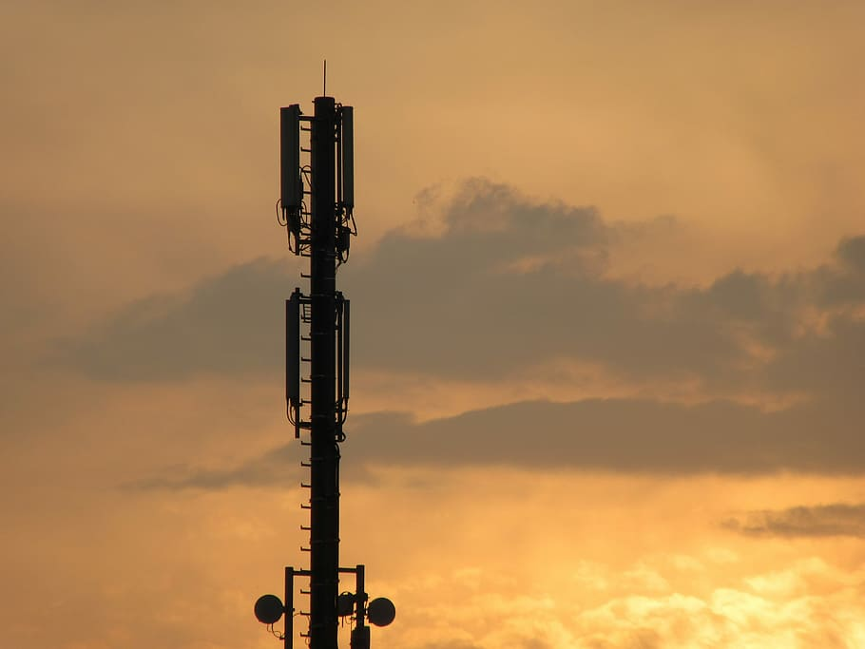
Future Scope
Transmitting Data from Observation Satellites
Communication within the Clusters of Satellites
Internet Broadband Service to Space Planes and Aircrafts
IoT and Connected Car

Slide 12
Reference
Slideshare
Youtube

